Slide 1

Learning Stochastic Parametric Differentiable Predictive Control Policies
Ján Drgoňa
Sayak Mukherjee
Aaron Tuor
Mahantesh Halappanavar
Draguna Vrabie
PNNL-SA-#####
Notes:
Image: Visualization of one years of Grid operation data with Gephi Graph Analytics

Slide 2
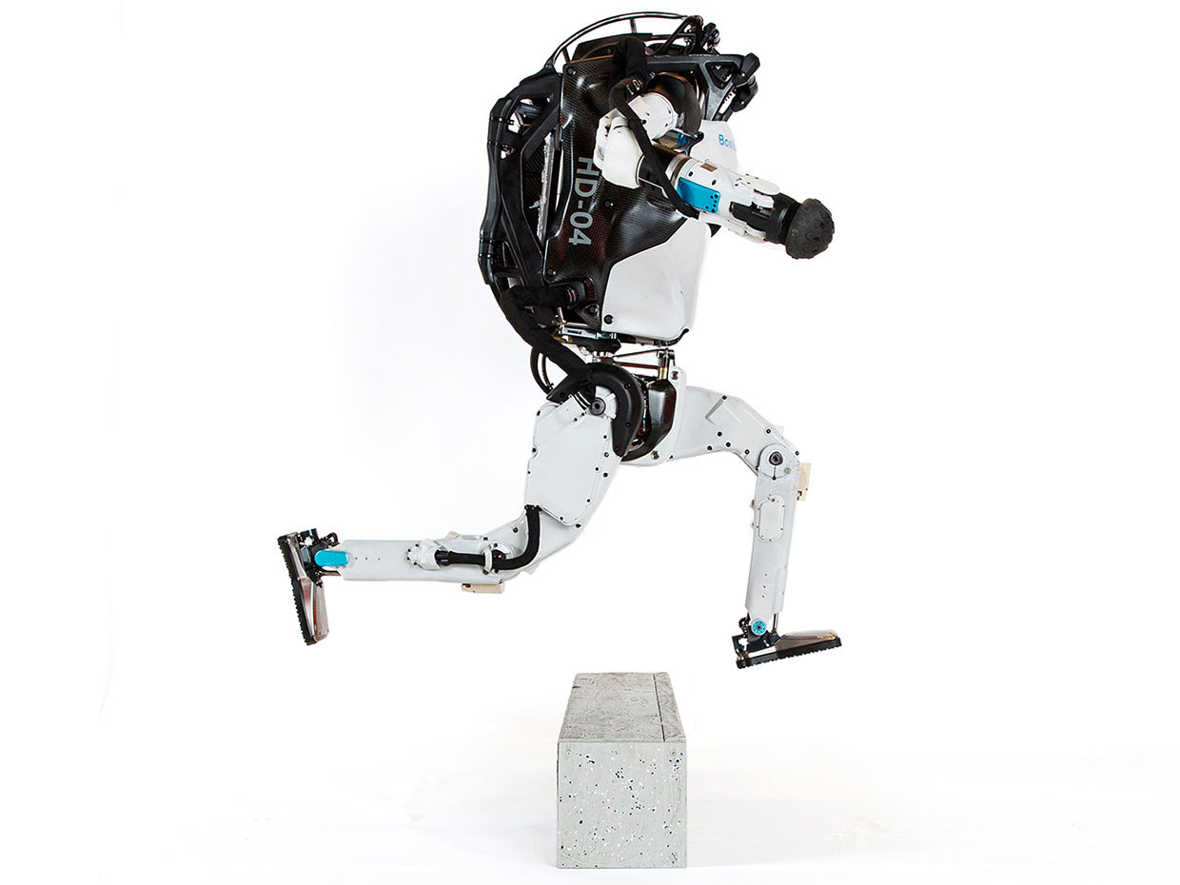


Model Predictive Control
Successes
Challenges
95% of the industrial control applications are PID loops & expert driven rule-based control (RBC).
The rest is model predictive control (MPC).
Modeling
Unknown or partially known dynamics
Physics-based modeling is expensive
Purely data-driven models lack generalization
Real-time optimization
Scalability
Computational limitations of control hardware
Parallelization, distributed optimization
Assumption:
Reliable and accurate system dynamics model
Drgona J., J. Arroyo, I.C. Figueroa, D. Blum, K. Arendt, D. Kim, and E.P. Olle, J. Oravec, M. Wetter, D. L. Vrabie, L. Helsen. 2020. "All You Need to Know About Model Predictive Control for Buildings." Annual Reviews in Control, September 29, 2020
2

Slide 3
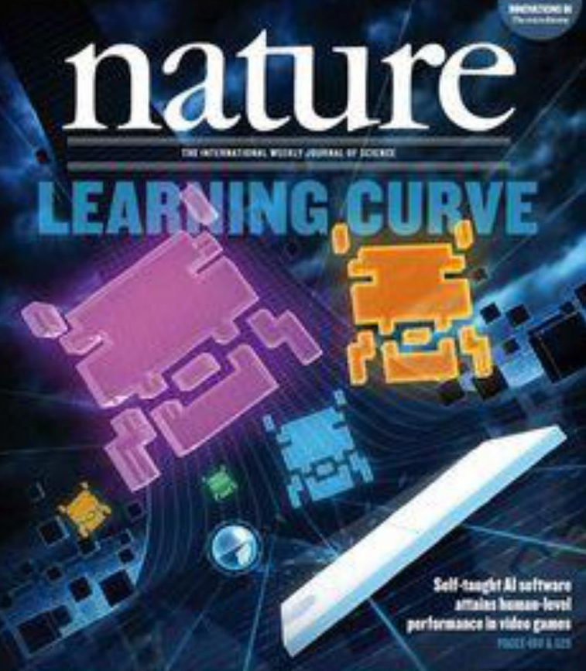
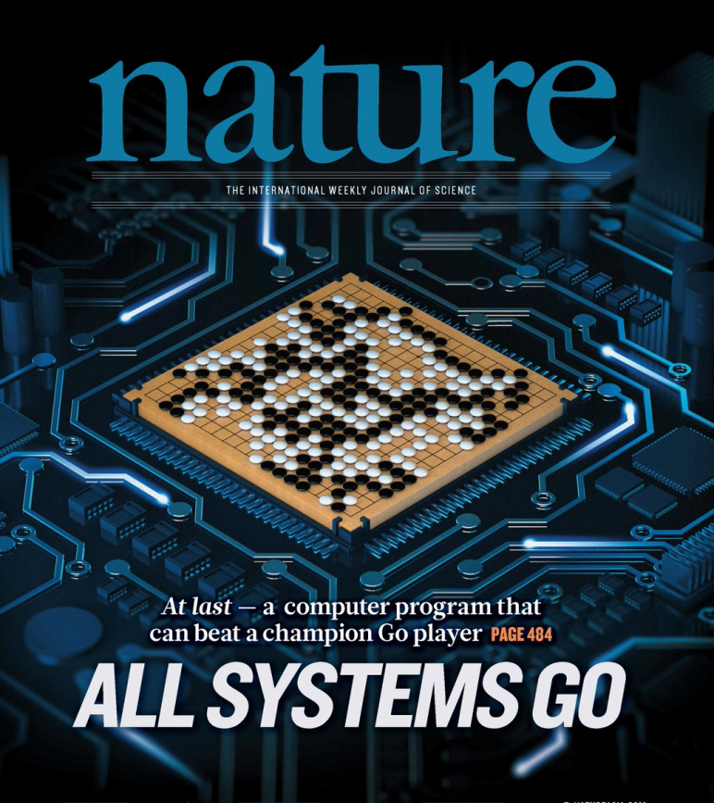
Deep Reinforcement Learning
Challenges
Successes
Dealing with constraints, and stability guarantees. Learning on real system with low data and low compute regimes. Offline learning. High-dimensional continuous state and action systems. Partial observability, time delays. Task generalization and intrinsic rewards.
Everywhere where you have reliable environment model, mostly discrete action space, and you can use massive offline compute power to solve the problem.
G. Dulac-Arnold, D. J. Mankowitz, and T. Hester, “Challenges of real-world reinforcement learning,”, 2019.
http://arxiv.org/abs/1904.12901

Slide 4

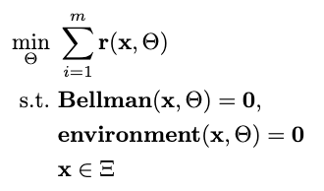

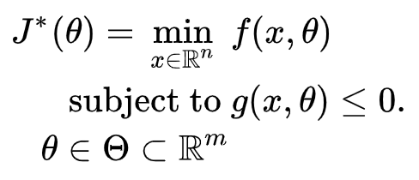

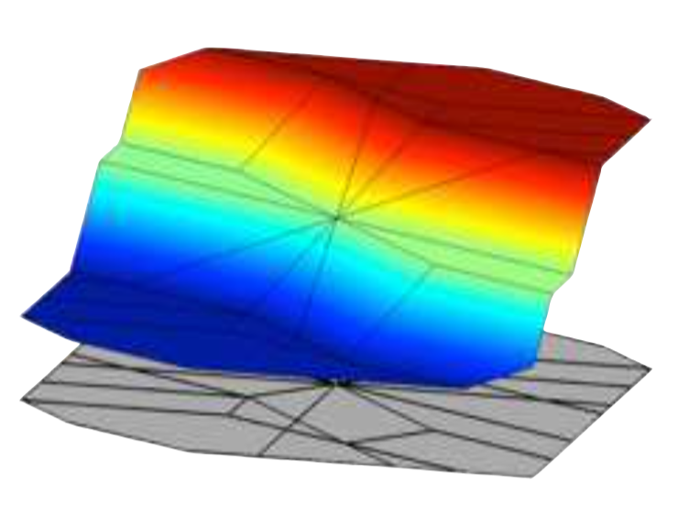
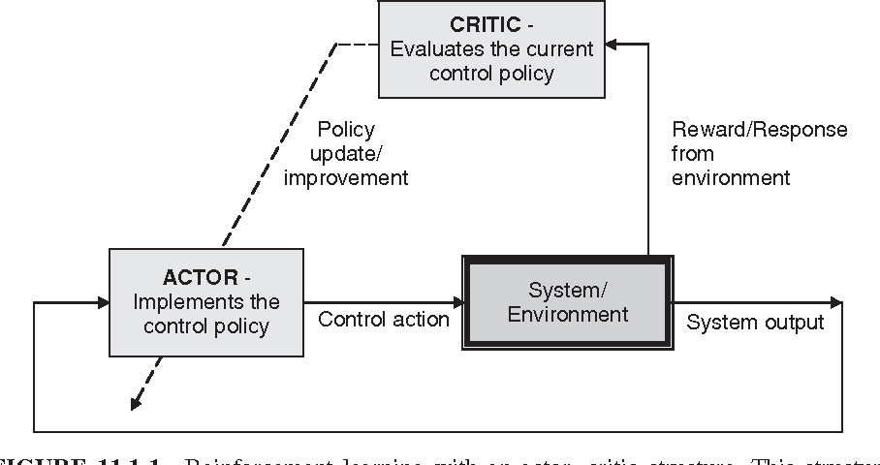

Optimization Methods for Control
Online MPC
Explicit MPC
Imitation Learning
Reinforcement Learning
“online” optimization
single solution for
given parameter values
implicit policy
“offline” optimization obtains a solution map
for a set of parameters
classical methods lead to exponential complexity!
“offline” optimization
obtains a model (map)
for a set of data points
scalable but requires expert controller
“offline” optimization
obtains a policy map
for a set of data points
poor convergence and
can’t handle constraints

Slide 5
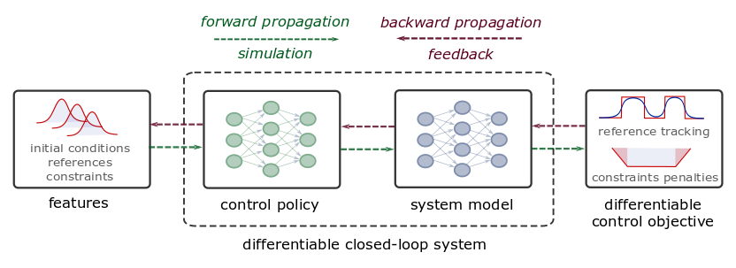
Differentiable Predictive Control
From data to explicit constrained control policy via differentiable optimization
Theoretical connection with MPC
Neural dynamical system models
Differentiable closed-loop model
Model-based policy optimization
Notes:
The conceptual methodology of DPC is illustrated here.
Assuming time series dataset obtained from the measurements of the system dynamics, in the first step, we perform system identification using a neural state-space model (SSM).
In the second step, we close the loop by combining the neural SSM with neural control law obtaining a differentiable closed-loop dynamics model fully parametrized by neural networks.
This allows us to leverage standard tools in deep learning to optimize the neural control laws by backpropagating the MPC loss function through the closed-loop dynamics.
Essentially this is a data-driven solution to multiparametric programming problems emerging from explicit nonlinear MPC.
Contrary to approximate MPC (aka imitation learning), DPC does not require supervision by an expert controller. Instead, a dynamics model is learned from a small dataset of system measurements, and the control law is then optimized offline by differentiating the learned system model.

Slide 6
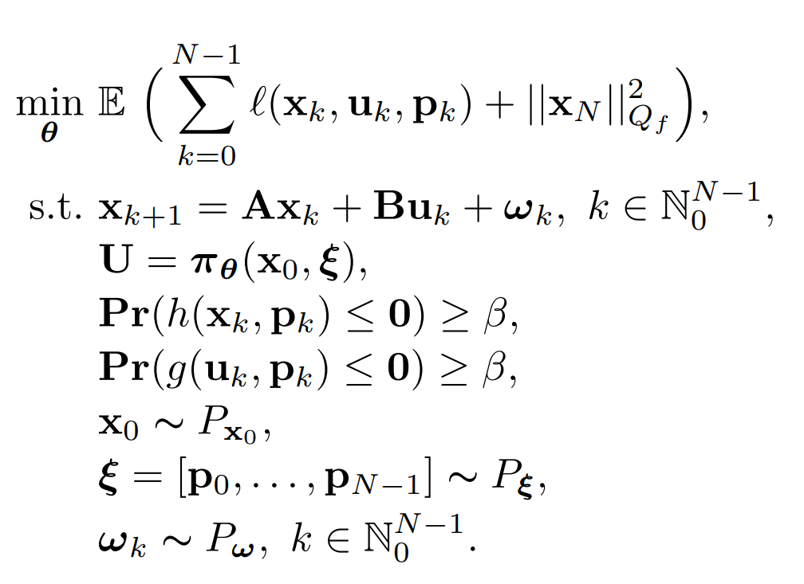
Stochastic Parametric Optimal Control
Problem definition:

Slide 7
Stochastic Parametric Optimal Control
Expectation of the objective function
Problem definition:
Stochastic linear system
Explicit predictive control policy
State and action chance constraints
Known initial conditions scenarios
Known parametric scenarios
Unknown disturbance scenarios

Slide 8
Stochastic Parametric Optimal Control
Expectation of the objective function
Problem definition:
Stochastic linear system
Explicit predictive control policy
State and action chance constraints
Known initial conditions scenarios
Known parametric scenarios
Unknown disturbance scenarios
Solve the problem with differentiable programming

Slide 9
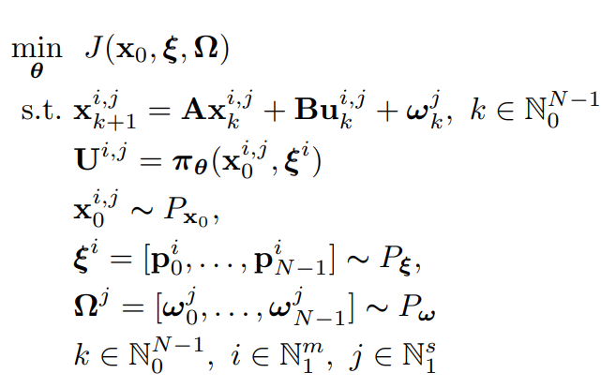
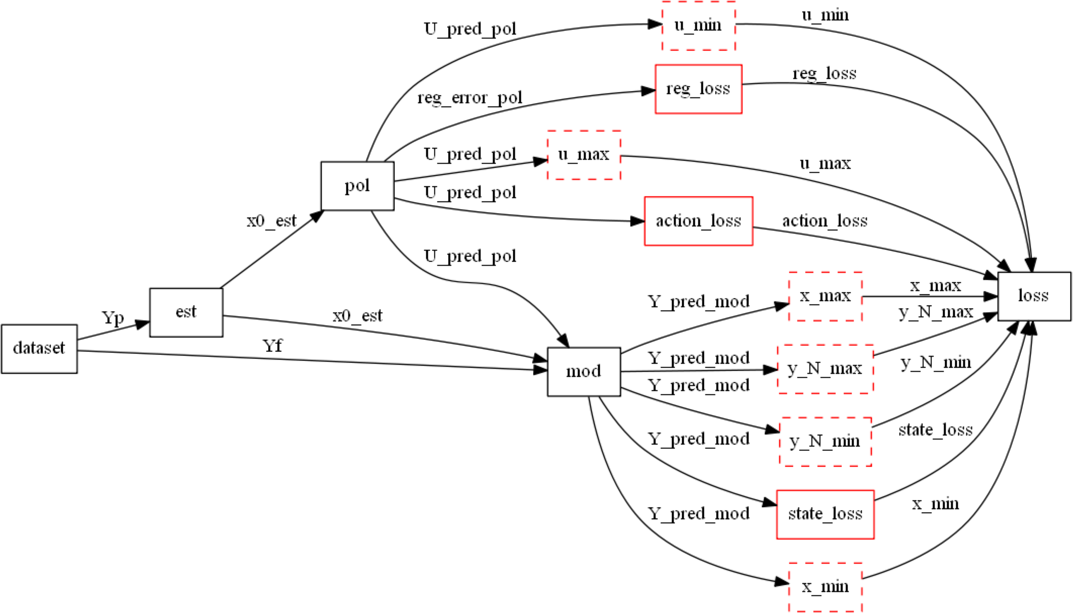
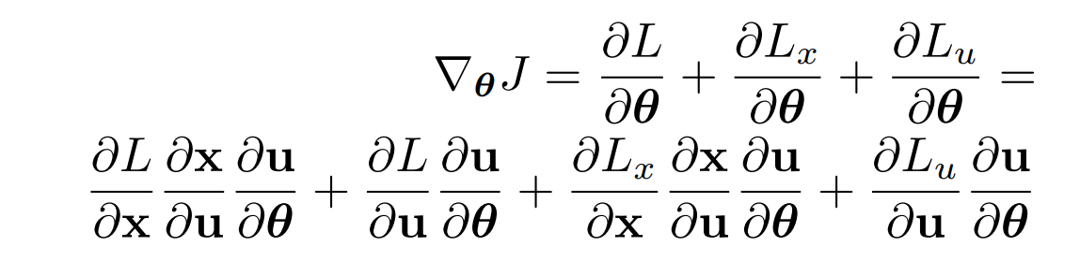
Differentiable Computational Graphs and Model-based Policy Gradients
Differentiate the computational graph to train the policies using state-of-the-art deep learning practice.

Slide 10
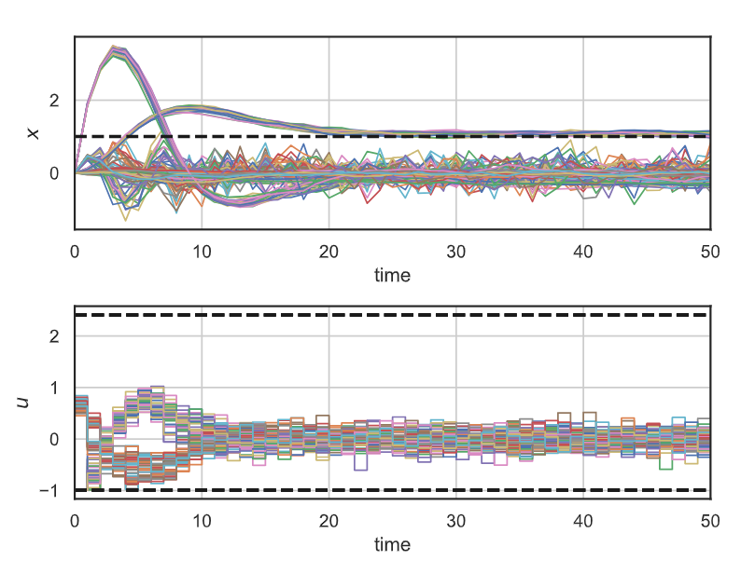
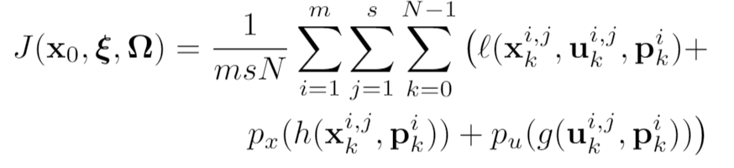
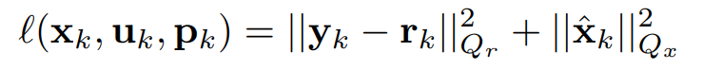
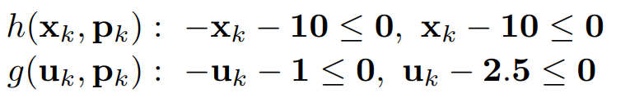
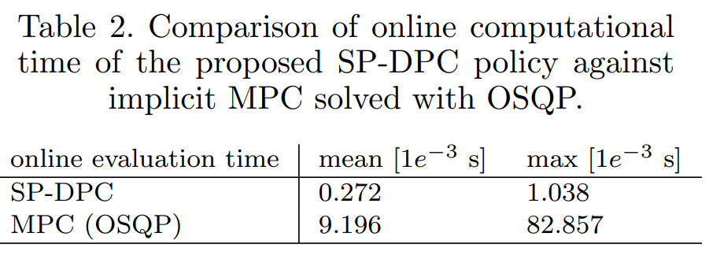
Stochastic Quadcopter Example
Order of magnitude faster than OSQP.

Slide 11
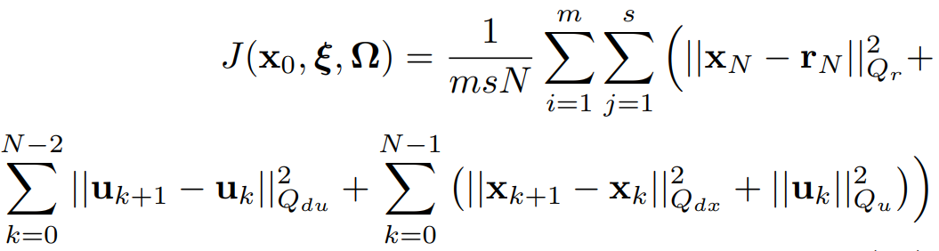
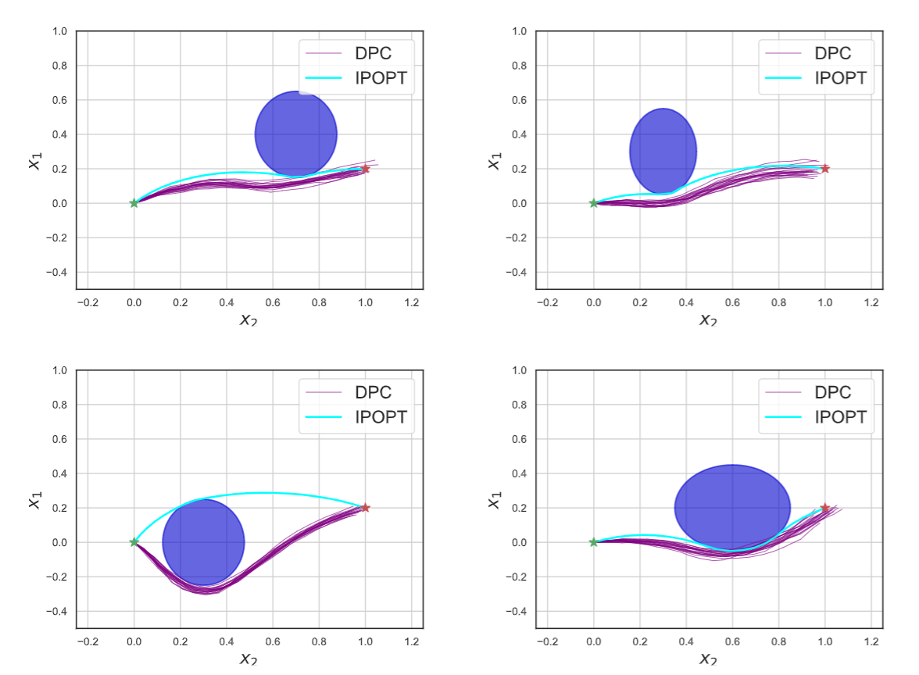
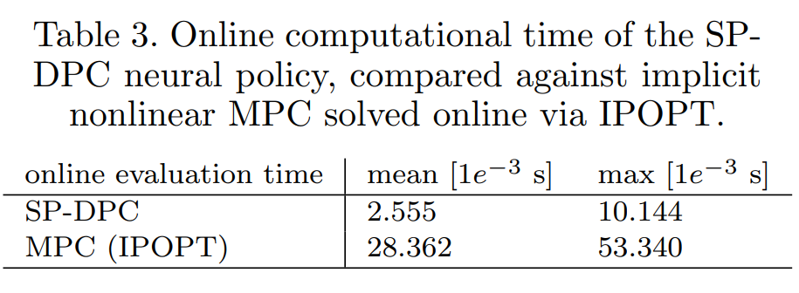
Stochastic Obstacle Avoidance Example
Order of magnitude faster than IPOPT.

Slide 12
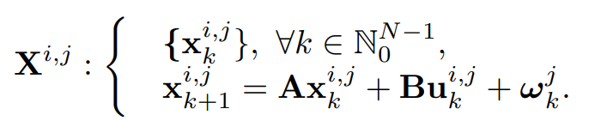
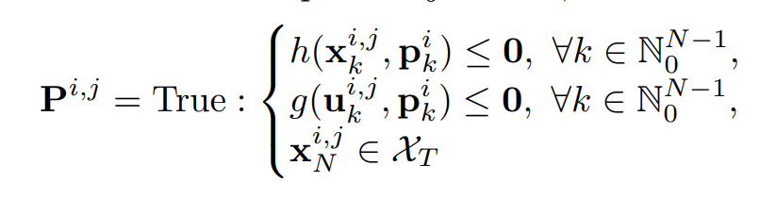
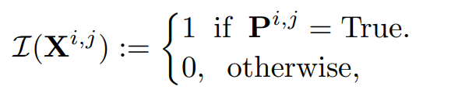
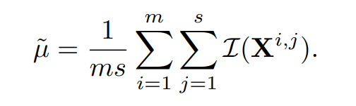
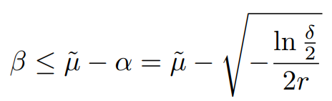
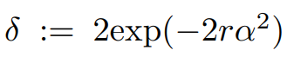
Probabilistic Guarantees
CL trajectories:
Safety metric:
Indicator function:
Empirical risk:
Number of samples
Hoeffding’s Inequality
(Hertneck et al., 2018):
Desired risk error lower bound
Empirical risk lower bound:
Confidence

Slide 13
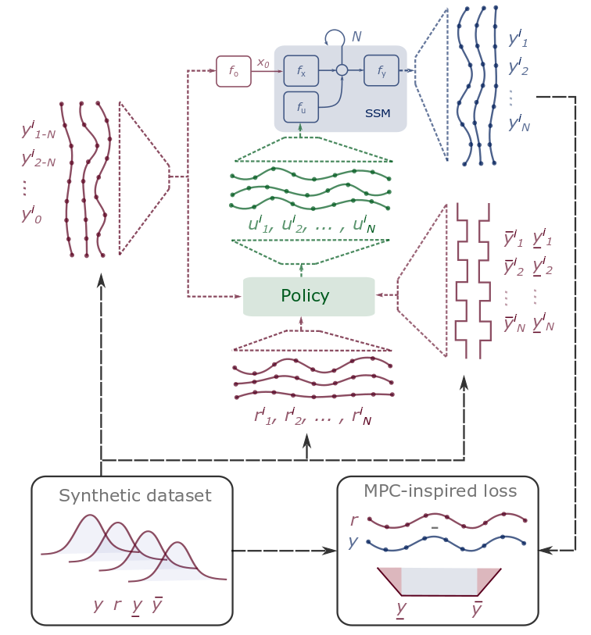

Conclusions
Differentiable Predictive Control
Differentiable system models
Explicit control policies
State and input constraints
Robustness to state disturbances
Open-source Code
Neuromancer software package in Pytorch
https://github.com/pnnl/neuromancer
Contact
jan.drgona@pnnl.gov
https://www.linkedin.com/in/drgona/

Slide 14
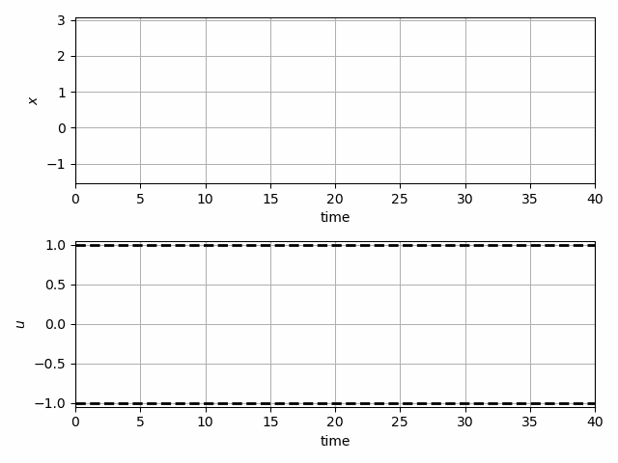
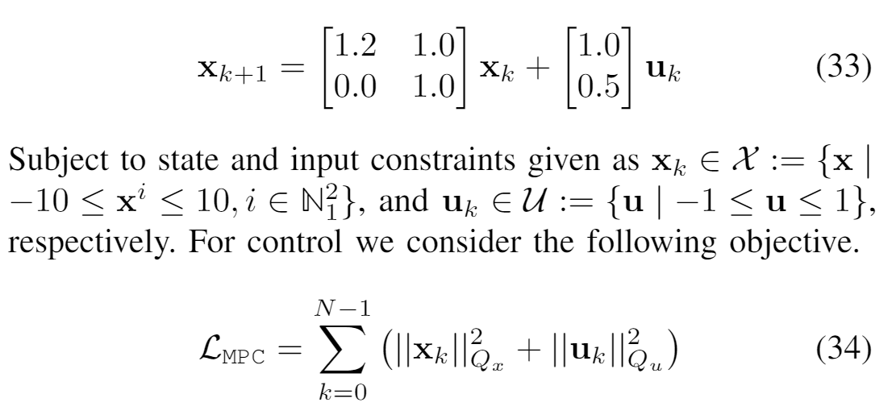
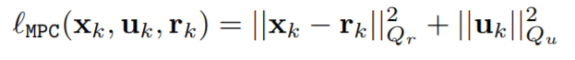
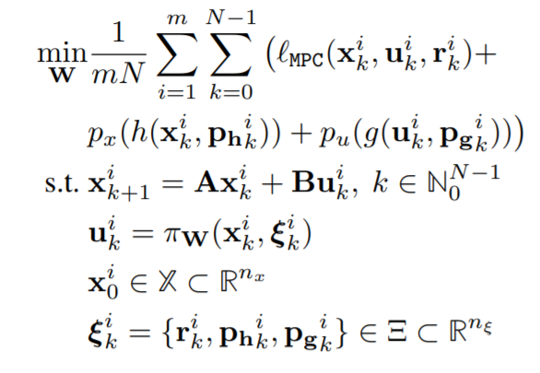
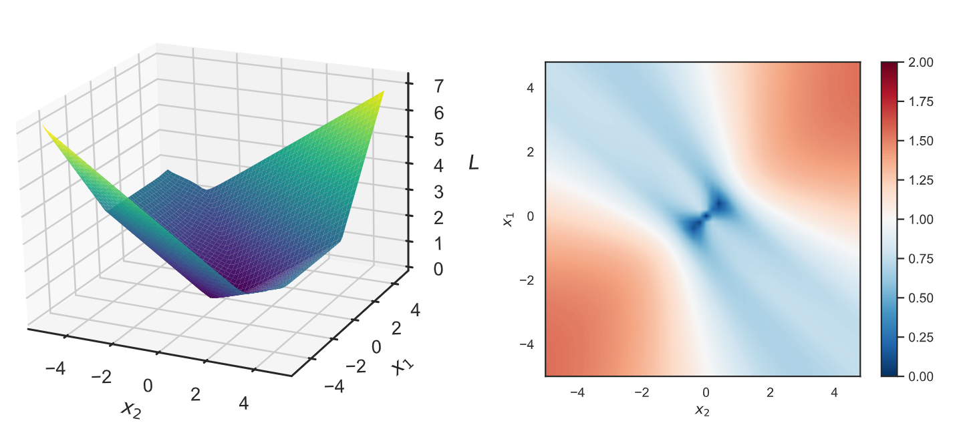
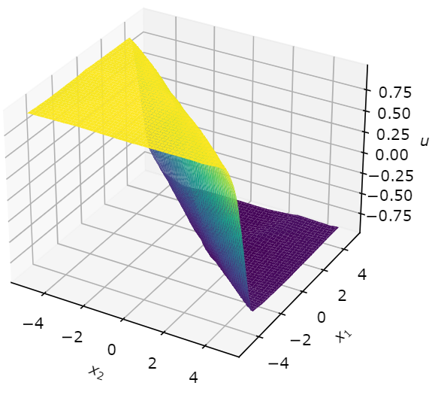
Learning to Stabilize Unstable System with Differentiable Predictive Control
Problem setup:
DPC formulation:
Jan Drgona, Aaron Tuor, Draguna Vrabie, Learning Constrained Adaptive Differentiable Predictive Control Policies With Guarantees
https://arxiv.org/abs/2004.11184

Slide 15
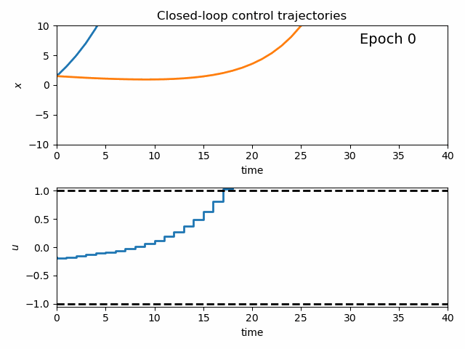
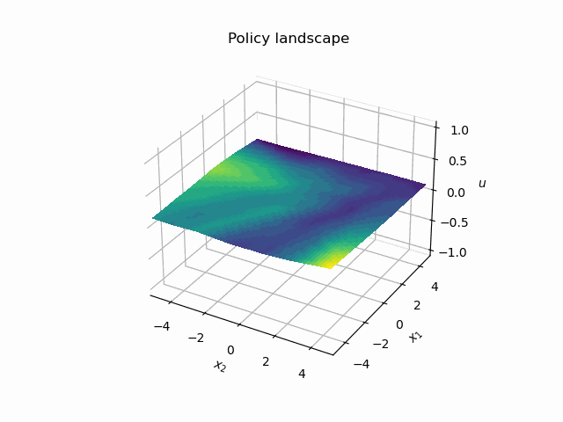
Dynamics of DPC Control Policy Learning
1341 learning parameters, 48.2 seconds offline training time on a CPU with 200 epochs.

Slide 16
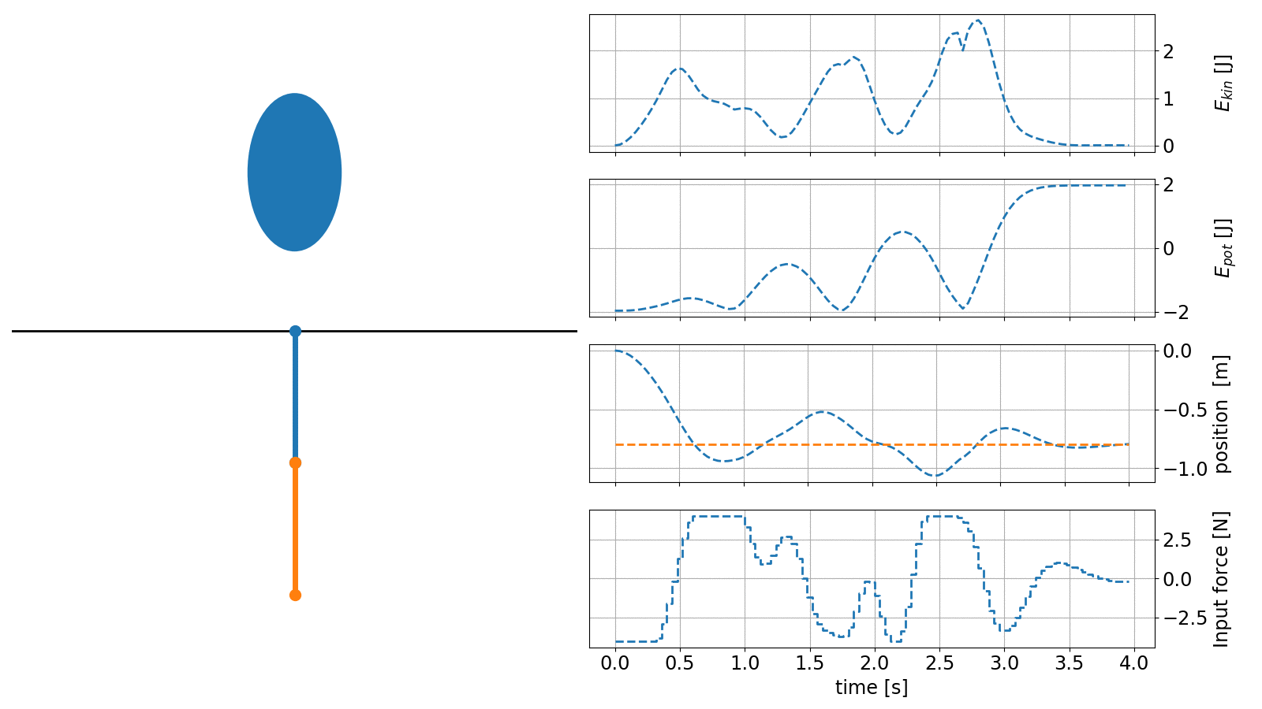
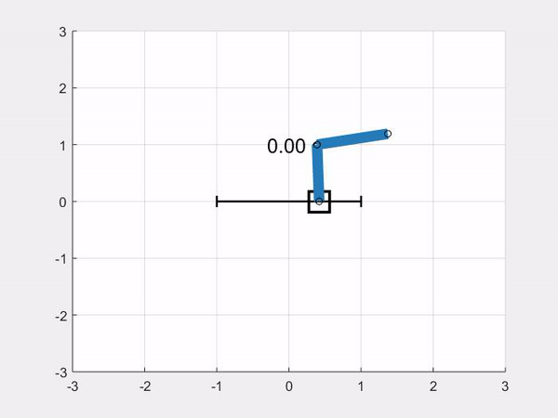
MPC and RL
https://www.do-mpc.com/en/latest/
https://openocl.github.io/
Requires system model
Parametrized value functions
Solves constrained optimization via solvers
Implicit policy
Requires system environment
Unknown value functions
Solves unconstrained optimization via backpropagation and gradient descent
Explicit neural policy
https://www.argmin.net/2020/06/29/tour-revisited/
Notes:
Online RL, on and off-policy RL, and offline RL.

